Slide 1

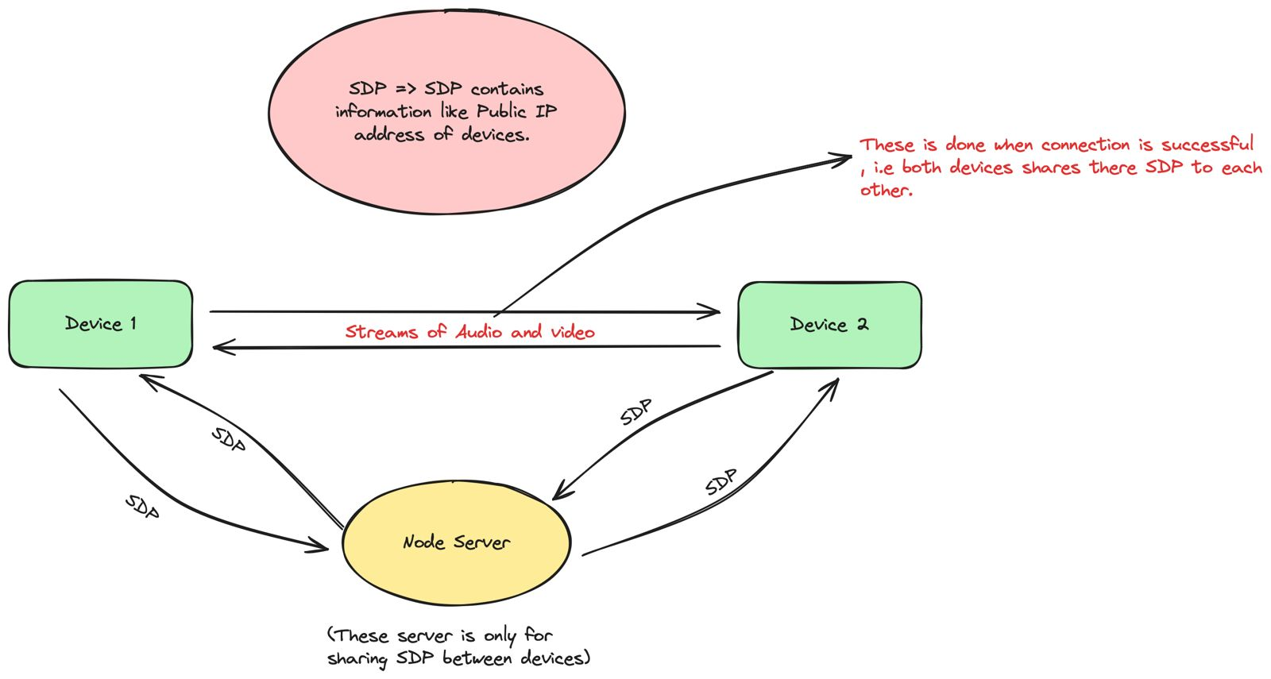
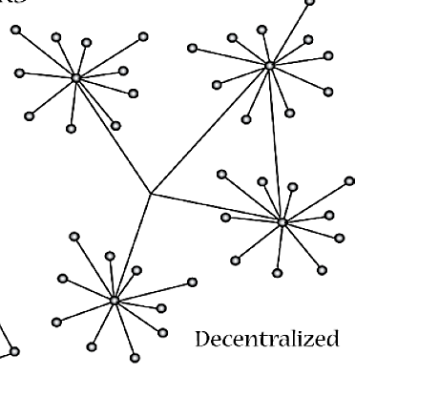
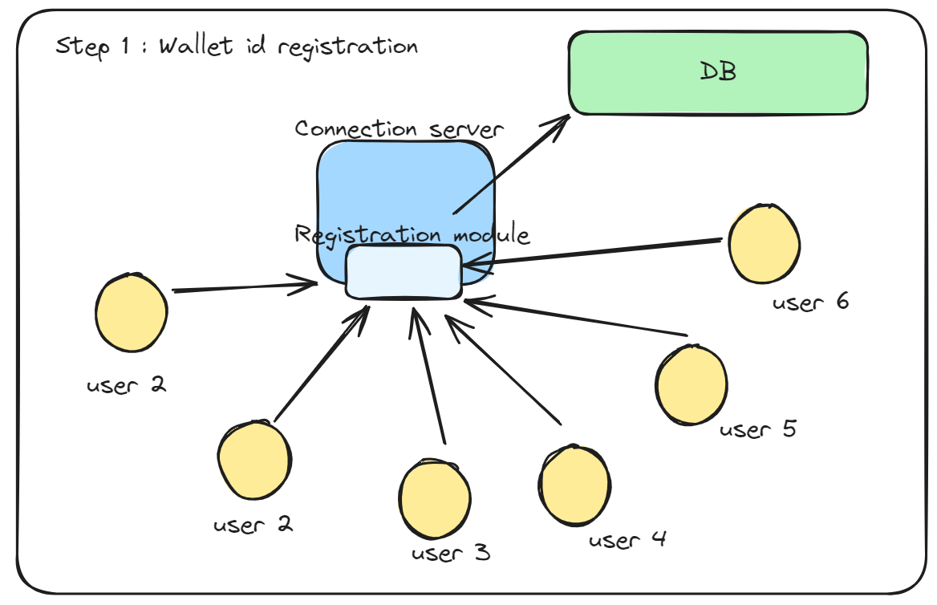
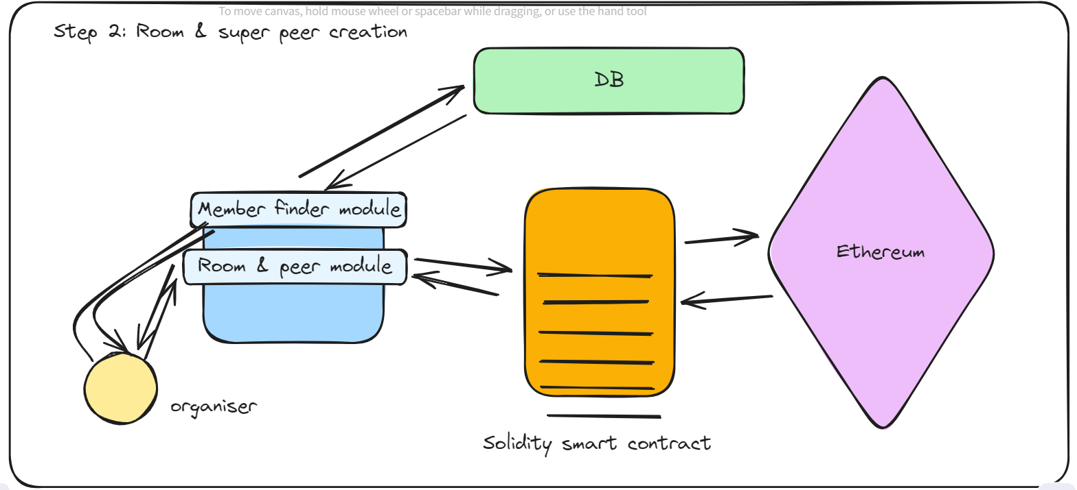
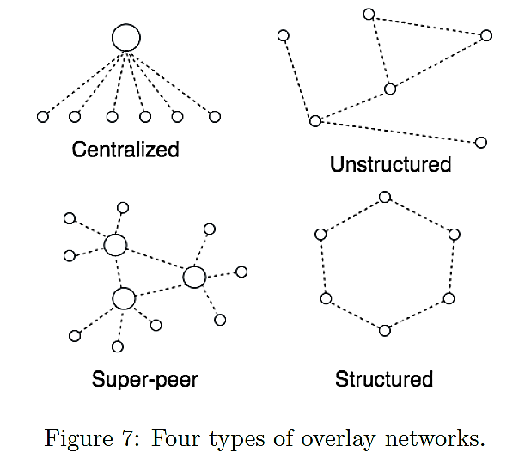
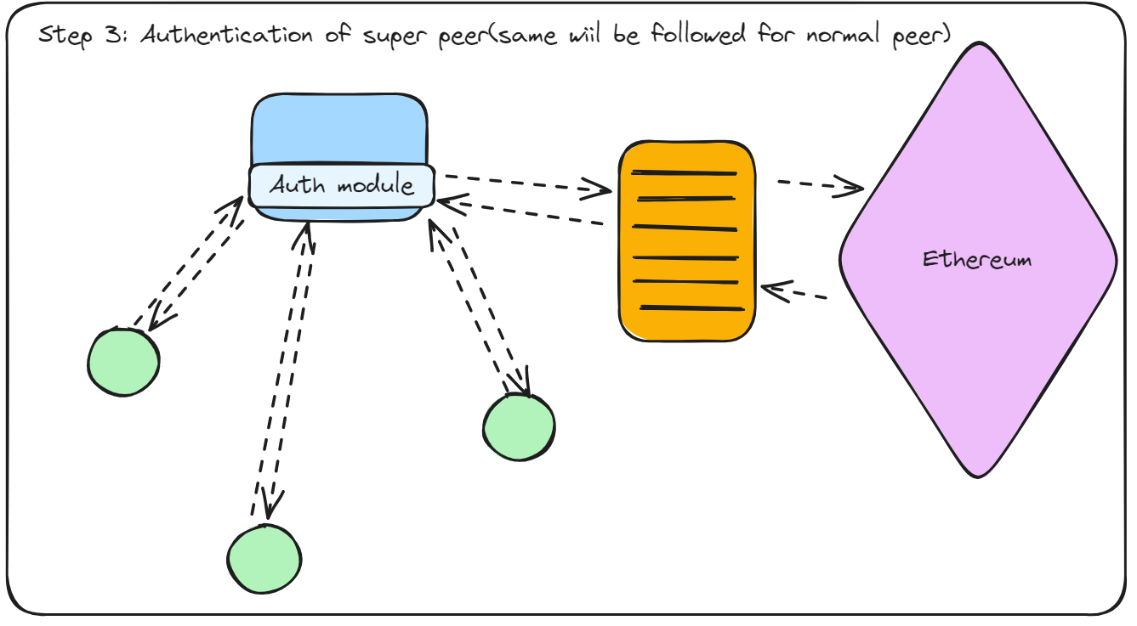
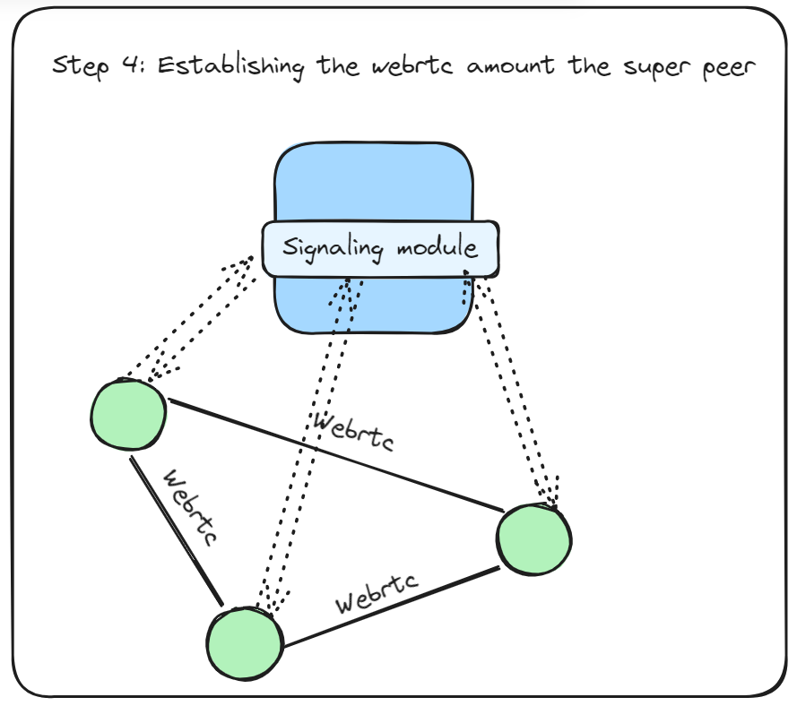
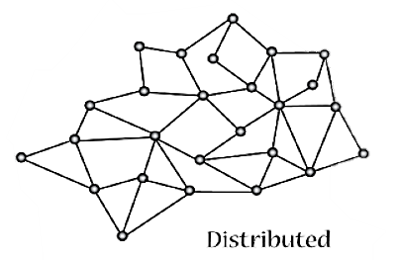
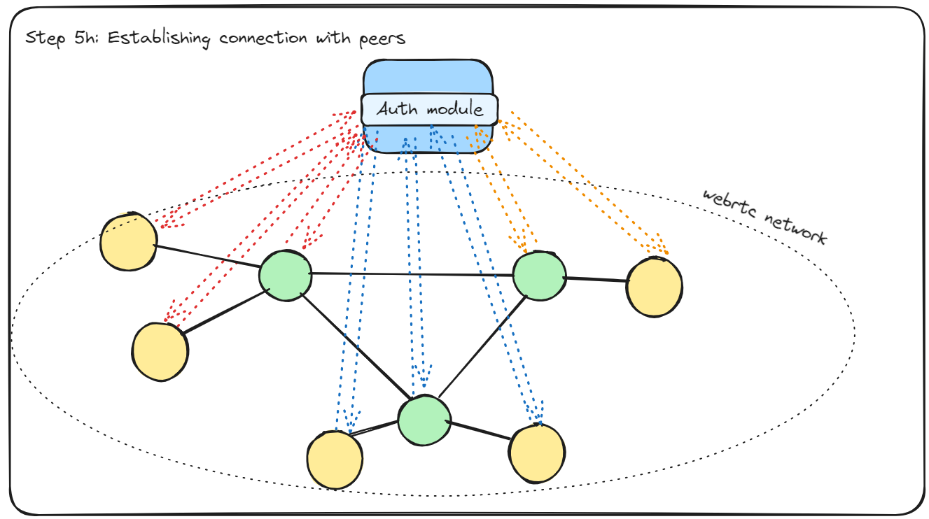
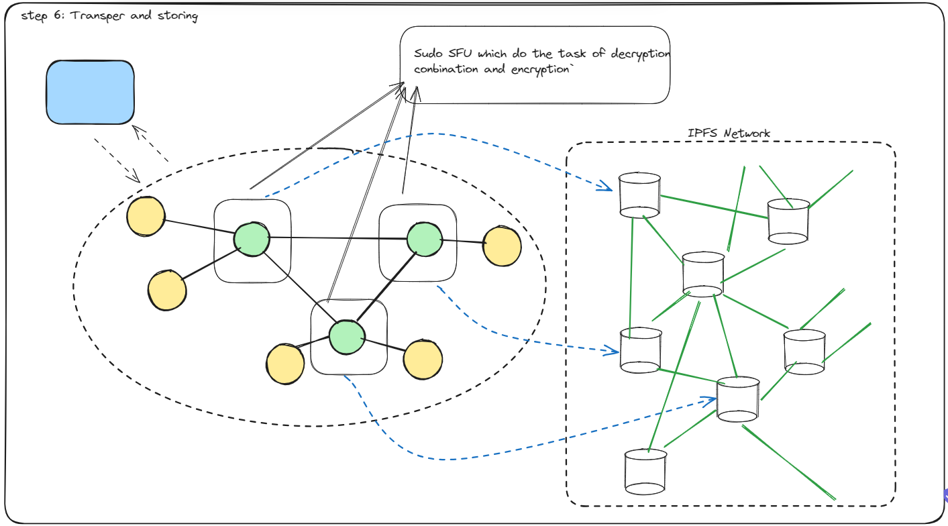
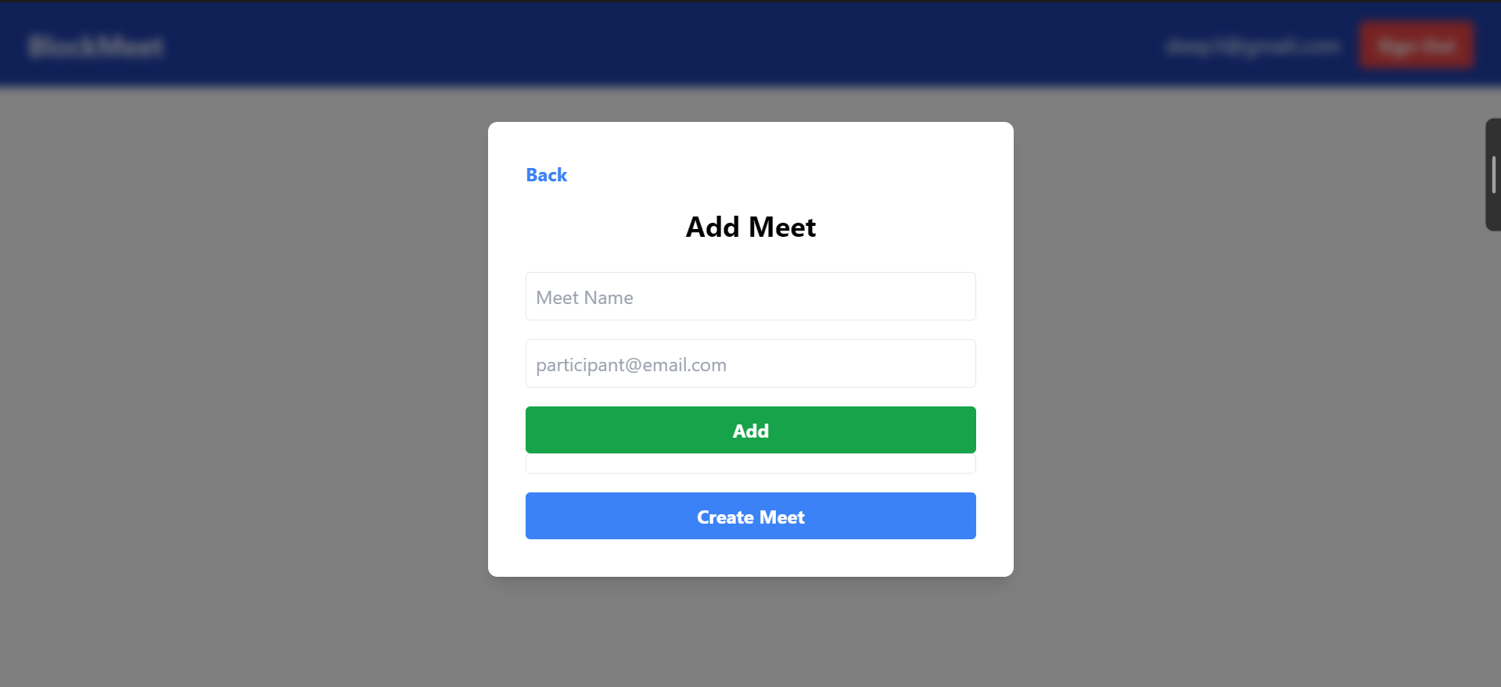
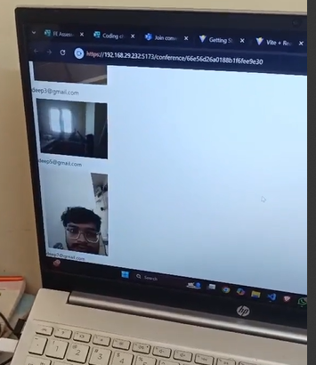
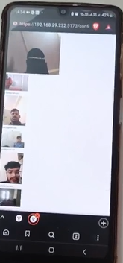
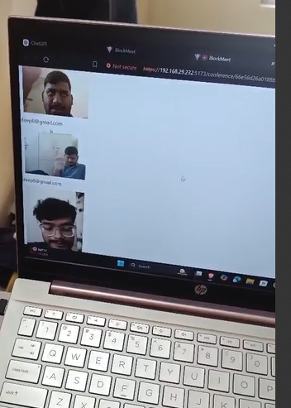
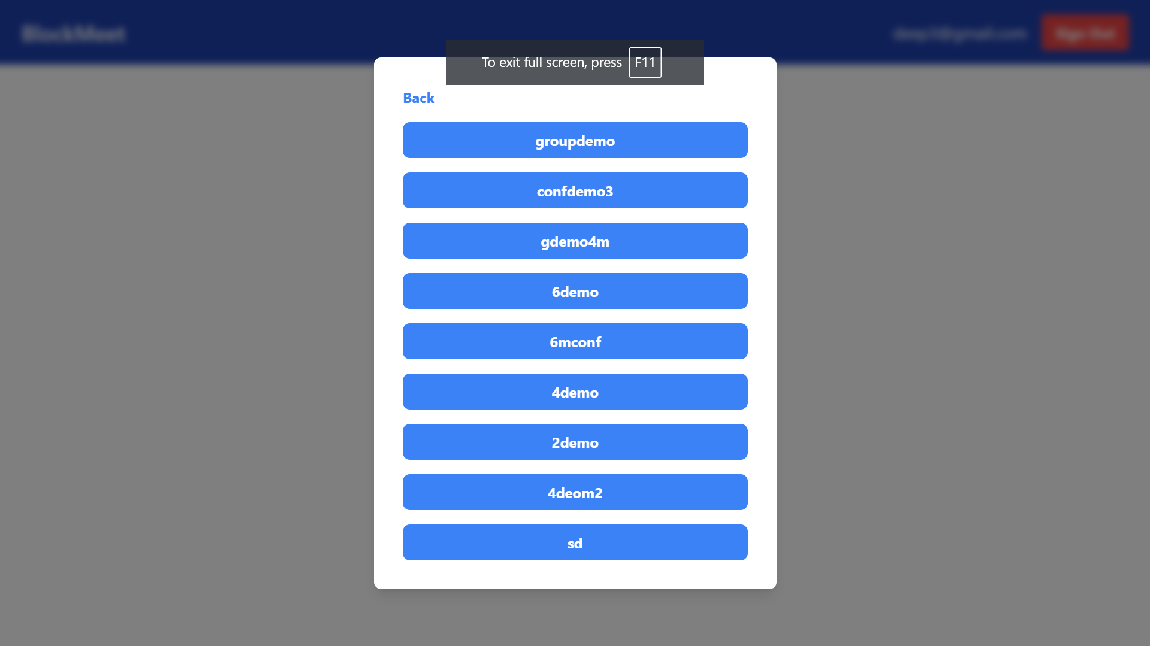
Department of Computer Engineering
Block Meet
Abstract
Methodology :
Our project focuses on the development of a decentralized video conferencing progressive web application (PWA) that leverages WebRTC for real-time communication.
The application utilizes Ethereum blockchain technology with Solidity smart contracts to enhance security and privacy. By decentralizing the video conferencing infrastructure, our app ensures resilience against single points of failure and offers users greater control over their data.
Encryption techniques based on blockchain concepts are implemented to safeguard communication channels and protect sensitive information. Through this innovative approach, our decentralized video conferencing app provides a secure, privacy-conscious solution for remote collaboration and communication. For storage we are going to used IPFS.
The following are the the technologies,techniques and methods that we planing to use
The Webrtc protocol : This is widely used protocol for p2p multi media transfer with any central authority.
Ethereum : The main purpose of using ETH is to make our application more transparent and secure.
The User Centric super peer decentralized architecture: This helps users to be the owner of their own conference networks.
IPFS : This Hashed based Decentralized storage system will ensure the data privacy of the the stored files.
Introduction
The growing reliance on video conferencing necessitates secure and privacy-preserving communication channels. This project tackles following challenges by developing a decentralized video conferencing app.
Centralized Data Storage: Current applications rely on centralized servers, posing risks to data privacy and security.
Data Privacy Concerns: Users sensitive information may be vulnerable to breaches or unauthorized access.
Censorship and Content Filtering: Some regions impose restrictions on communication platforms, limiting users freedom of expression.
Lack of User Control : Users may have limited control over their data and content, raising concerns about data ownership.
To achieve decentralization ,the Ethereum blockchain along with Solidity smart contracts form the backbone of the application along with IPFS as storage service . This eliminates reliance on centralized servers, a potential vulnerability in traditional video conferencing platforms. By incorporating blockchain technology, we aim to enhance security and privacy by leveraging its core features of immutability and transparency.
Flow Diagram
The Registration step
The Users will Register in our application
They need to create a wallet using services like meta mask, Back packet
We will be storing this data in our DB so that when a user is trying to add participant in meet they can search them
Room creation
Here user will create the meet , and define the members .
This is the steps were the user will define which are the other super peers
Literature Survey
Following Architectures are used
A centralized overlay network facilitates resource-sharing directly between peers, but relies on a central point for discovery. For example, Napster operated as a centralized overlay network where users shared files directly but relied on the Napster server for file and user discovery . Zoom , Google meet uses this type of architecture.
Authentication step
This diagram shows how the user that request to join the meet are authenticated
The super peer must join the room to initiate the initial webrtc network
Super-peer networks is a mix of centralized and decentralized. Super-peers relay messages, acting as hubs for efficient info sharing while keeping peer-to-peer communication.
In a distributed network, there is no central server coordinating communication between devices on the network. The devices themselves handle these tasks, communicating with each other directly. This can make distributed networks more scalable and fault-tolerant than centralized networks, where a central server failure can disrupt the entire network.
Super peer webrtc network
This Diagram shows the formation of the final webrtc network which is the core of our decentralized data transfer without the use of centralized SFU like meet and teams
The Process of formation of this network used the core logic provide by webrtc include SDP and ICE exchange among the peer
The above displayed are some widely used architecture for video conferencing application ,along with with distributed one which Collected from :
Paper1 : https://ijcaonline.org/archives/volume183/number16/hettiarachchi-2021-ijca-921490.pdf
Paper 2 : https://sci-hub.se/10.1109/ICCIT51783.2020.9392746
Peer Network formation
This diagram shows how the final state of peer network will look like
We will make sure that the peers are well distributed as it is essential for smooth functioning of the app.
Objectives
Decentralized Architecture: Develop a video conferencing platform that operates on a peer-to-peer network using WebRTC, eliminating reliance on centralized servers for improved security and censorship resistance.
Enhanced Security & Privacy: Leverage Ethereum blockchain and Solidity smart contracts to implement robust encryption for user data and communication, ensuring privacy and protection from unauthorized access.
Real-Time Communication: Utilize WebRTC to enable high-quality, low-latency audio and video communication between participants in real-time.
Progressive Web App (PWA): Design the application as a PWA for seamless accessibility across various devices (desktops, mobiles) without requiring app store installations.
User-Centric Design: Create an intuitive and user-friendly interface that facilitates secure and efficient video conferencing experiences.
Recording storage
The diagram aside shows how the data is stored in the IPFS
The use of IPFS ensure the decentralized data storage
Protype
.
TEAM:
Deep Salunkhe
Omkar Patil
Sukant Thombare
Pranav Redij
Guide : Dr . Sachin Bojewar

